Slide 1
EOPEN T7.3: User Training
PUC 1: EOPEN User Training Material Outlook
AAWA

Slide 2
Table of Contents
1. Background
2. The EOPEN Platform
for flood reduction
3. Practical Training
4. Visualization
User Training Material

Slide 3
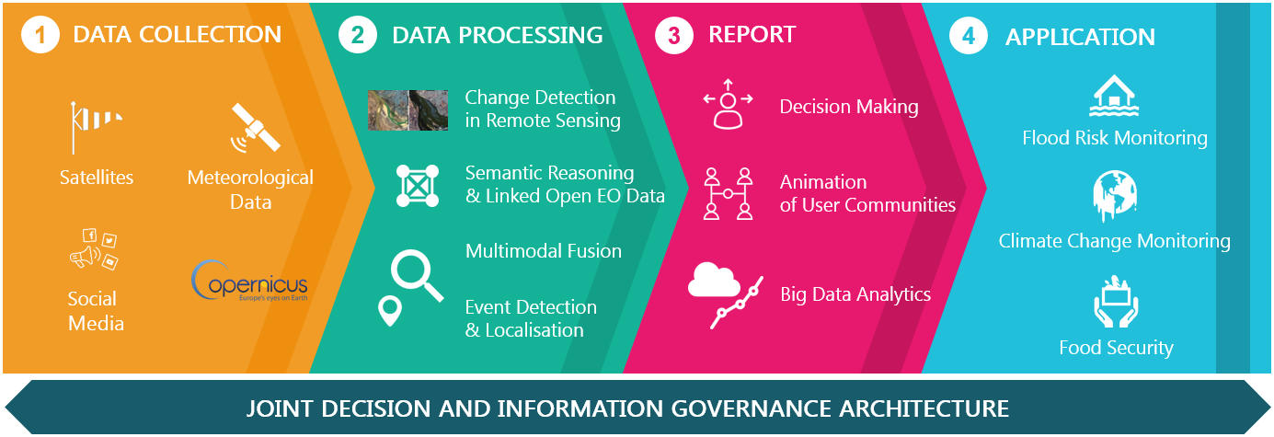
1. Background
1.1 Background of EOPEN
EOPEN provides a platform targeting non-expert Earth Observation (EO) data users (non-traditional user communities), experts and the SME community
The platform makes Copernicus data and services easy to use for Big Data applications by providing EO data analytics tools, decision making, and infrastructure
And also it can support the Big Data processing life-cycle allowing the chaining of value-adding activities across multiple platforms
User Training Material

Slide 4
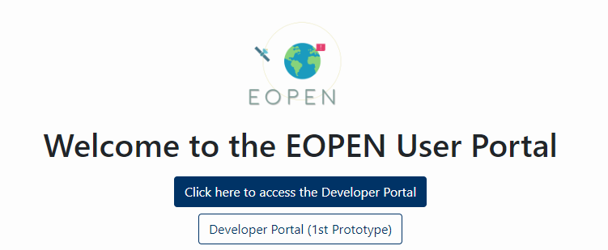
1. Background
1.2 Objective
Give the opportunity to use the results of EOPEN for end-users, and interested third-parties.
A detailed encounter for the efficient use of platform.
Promotes additional engagement activities, training activities, pursues a significant widen use of the EOPEN platform, and contributes to the uptake of EO data from the community.
Be supplied to EOPEN's various capacity building activities, and bring effects that will outlast the project timeframe, contributing to the sustainability of EOPEN approach and system.
User Training Material

Slide 5
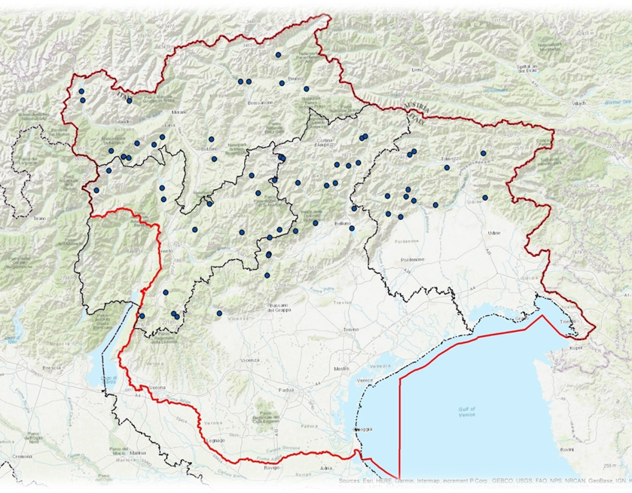
1. Background
1.3 The Eastern Alps river basin district
The competence of the Authority (AAWA) covers the Autonomous Provinces of Trento and Bolzano, the Regions of Veneto, Friuli Venezia Giulia, and parts of basins falling within the borders of Switzerland, Austria and Slovenia.
Overall, the District covers an area of over 37,000 km2.
User Training Material

Slide 6
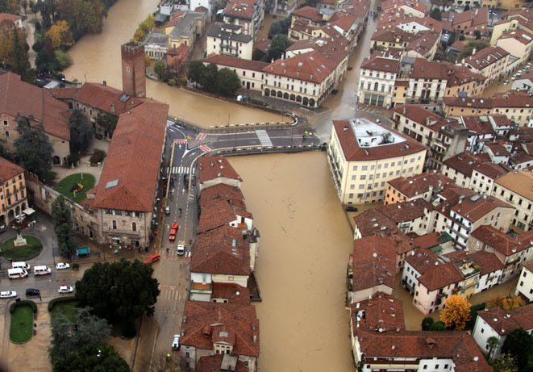
1. Background
1.4 Floods in Italy
The average annual precipitation is highly variable with increasing trend in the South-North direction at least up to the first orographic obstacle constituted by the pre-Alpine belt.
The average annual values vary from just under 700 mm found in the southernmost part of the Veneto Region (province of Rovigo) to over 3,000 mm found in the Musi area of Lusevera and Uccea located near the border with Slovenia.
User Training Material

Slide 7
1. Background
1.4 Floods in Italy
Six major rivers flows inside the district: the Isonzo, the Tagliamento, the Livenza, the Piave, the Brenta-Bacchiglione and the Adige, all streams with high slopes and fluvial-torrent character, with average flows annual substantially between 80 and 100 m3 / sec and full flow between 2,500 and 5,000 m3 / sec
User Training Material

Slide 8
1. Background
1.5 The importance of ground truth
In Remote Sensing, Ground truth is the information or data collected on site so that the input data (image) can be related to the actual features and is considered to be much correct and appropriate than the input features. This process compares the pixel on a satellite image to what is there in reality (at the present time) in order to verify the contents of the pixel on the image
User Training Material

Slide 9
1. Background
1.6 The Copernicus Program and Satellite
Copernicus is the European Union's Earth Observation Programme, looking at our planet and its environment for the ultimate benefit of all European citizens. It offers information services based on satellite Earth Observation and in situ (non-space) data.
The Programme is coordinated and managed by the European Commission. It is implemented in partnership with the Member States, the European Space Agency (ESA), the European Organisation for the Exploitation of Meteorological Satellites (EUMETSAT), the European Centre for Medium-Range Weather Forecasts (ECMWF), EU Agencies and Mercator Océan.
User Training Material

Slide 10
1. Background
1.6 The Copernicus Program and Satellite
Vast amounts of global data from satellites and from ground-based, airborne and seaborne measurement systems are being used to provide information to help service providers, public authorities and other international organisations improve the quality of life for the citizens of Europe. The information services provided are freely and openly accessible to its users.
User Training Material

Slide 11
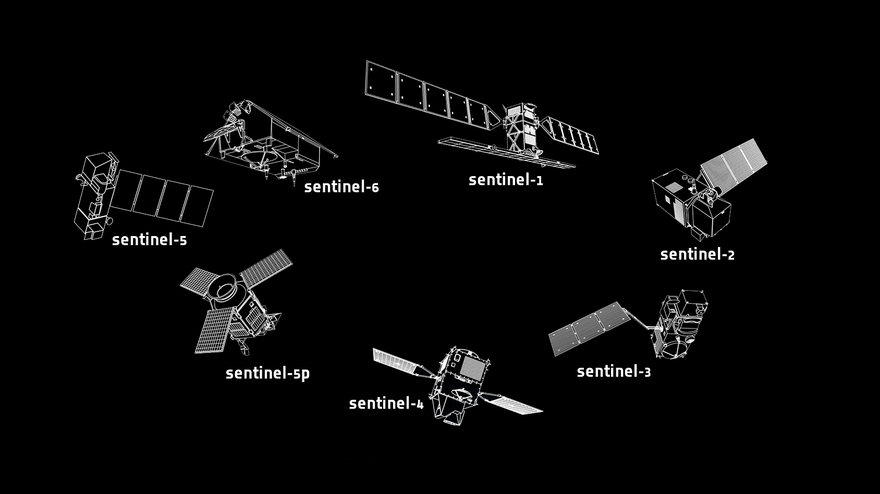
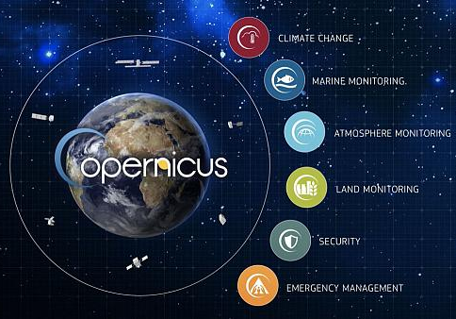
1. Background
1.6 The Copernicus Program and Satellite
User Training Material

Slide 12
2. The EOPEN Platform for flood reduction
2.1 New methodology to derive flooded areas
The EOPEN platform provides the opportunity to develop the concept of flooded area delineation. With EOPEN users can merge the information provided by classic hydraulic models with satellite imagine and data from social media inside a unique platform without the needs of a specific ICT infrastructure.
PRECURSORS:
Hydraulic models and simulations
CONFIRMATION:
Ground truth (tweets)
Satellite imagine and maps
User Training Material

Slide 13
2. The EOPEN Platform for flood reduction
2.2 The hydrological and Hydraulic model to predict floods
The Flood Maps; those maps comes as results of the hydraulic model; the model geometry is generated offline by technician; boundary conditions comes from the last hydrological run of AAWA model. The user will be able to upload the geometry and boundary files into EOPEN, run the algorithm and download results. Once accepted the user will upload Flood maps for any user.
User Training Material

Slide 14
2. The EOPEN Platform for flood reduction
2.2 The hydrological and Hydraulic model to predict floods
The schema below show the interaction between several datasets and several infrastructure to provide important information for flood risk reduction
EOPEN
Copernicus Land Service maps
AAWA EWS
HIRLAM Wather forecast
Check the forecast total rain on subbasins
Less than treshold
Do nothing
Hydrological model
Over treshold
Alarm to AAWA, creation of EVENT in EOPEN
Setup of Basement simulation
Run in EOPEN (manually)
User Training Material

Slide 15
2. The EOPEN Platform for flood reduction
Weather forecasts
Hydrological and Hydraulic models
Satellite Observations
Ground Truth (tweets)
2.3 New methodology to derive flooded areas
To:
Advantages of EOPEN
From:
Weather forecasts
Hydraulic models
Surveys
Costs
Time
Time
Costs
User Training Material

Slide 16
2. The EOPEN Platform for flood reduction
2.4 EOPEN capabilities for flood management
Secure Storage
Speedup
User Training Material

Slide 17
2. The EOPEN Platform for flood reduction
2.4 EOPEN capabilities for flood management
One important advantage of EOPEN is that once a user generate a product can also decide to public the content on the platform for other users, this part permit to save time and money.
Sharing contents between users
User Training Material

Slide 18
2. The EOPEN Platform for flood reduction
2.5 Satellite imagine and water presence maps
Products available and tools for flood risk reduction
The Water Presence Maps (WPM): maps of the areas covered by water (flooded and non flooded areas)
Satellite
Acquisition of a raw product
Ground segment
Storage and elaboration of a raw product
EOPEN
Elaboration and extraction of flooded areas
User Training Material

Slide 19
2. The EOPEN Platform for flood reduction
2.5 Satellite imagine and water presence maps
Products available and tools for flood risk reduction
The Water Presence Maps (WPM): those maps are the output of the water detection algorithm; this algorithm daily search into the catalogue if there is any new S1 or S2 imagine available and from them derive the maps that indicates the presence of water. The output are corrected applying masks to delete waterbodies and other permanent pool from the maps.
User Training Material

Slide 20
2. The EOPEN Platform for flood reduction
2.5 Satellite imagine and water presence maps
EOPEN, flowchart to derive a WPM (water presence map)
WPM Workflow
Permanent water bodies masks
Other specifc mask and tresholds
SAR and Optical imagine
User Training Material

Slide 21
2. The EOPEN Platform for flood reduction
2.6 Social media data
The ground truth are the feedback from the territory. EOPEN platform can every day scan the web to derive data from social media, in this case tweets, to provide more information about the situation.
User Training Material

Slide 22
3. Practical Training
3.1 WORKFLOWS
The platform most important feature is the ASB.
The ASB is a framework enabling platform and application agnostic solution for implementing complex processing chains over globally distributed processing and data resources.
ASB provides a “low coding” solution to develop a data processing facility based on orchestrated workflows.
User Training Material

Slide 23
3. Practical Training
3.3 EOPEN Event detection module
Inside the platform exists many different workflows defined by users or created by the EOPEN team. One of this workflows already implemented inside EOPEN is the Event detection module; this module send a notification every time a rain threshold is exceed.
EOPEN, last Hirlam forecast on the platform
EOPEN will check Precipitation tresholds
EOPEN will rise an alarm (email and notification)
User Training Material

Slide 24
3. Practical Training
3.3 EOPEN Event detection module
The event detection workflow
The event detection module specifically check the Hirlam forecast every time HIRLAM consortium publish a new forecast. For each timestep the workflow check the threshold exceedance of a variable (es. Rain rate) and send eventually a notification to the user.
Each box present input and output of the process
User Training Material

Slide 25
3. Practical Training
3.2 EOPEN workflow to derive a WPM
Water presence maps comes from a predefined algorithm developed by CERTH based on Sentinel S1 and S2 observation with several corrections (permanent water bodies, elevation etc.). Following this method remains only the flooded areas.
To run the algorithm users should only select the workflow (users can also modify the workflow) and run it inside the platform.
The algorithm works also automatically and users will be able to visualize results directly in EOPEN.
User Training Material

Slide 26
3. Practical Training
3.3 Obtain a Flood Maps
To obtain a flood map and to prepare the hydraulic model each user need some software and plugins (freeware) listed below:
Softwares:
Plugins:
User Training Material

Slide 27
3. Practical Training
3.3 Obtain a Flood Maps
Starting from a Basement simulation results obtained on the platform, to convert data into raster and verify results users can follow the scheme below that uses free software previously mentioned:
User Training Material

Slide 28
3. Practical Training
3.3 Obtain a Flood Maps
Basement on EOPEN
User Training Material

Slide 29
3. Practical Training
3.3 Obtain a Flood Maps
Open the geometry from the 2dm file, it represent the initial geometry
User Training Material

Slide 30
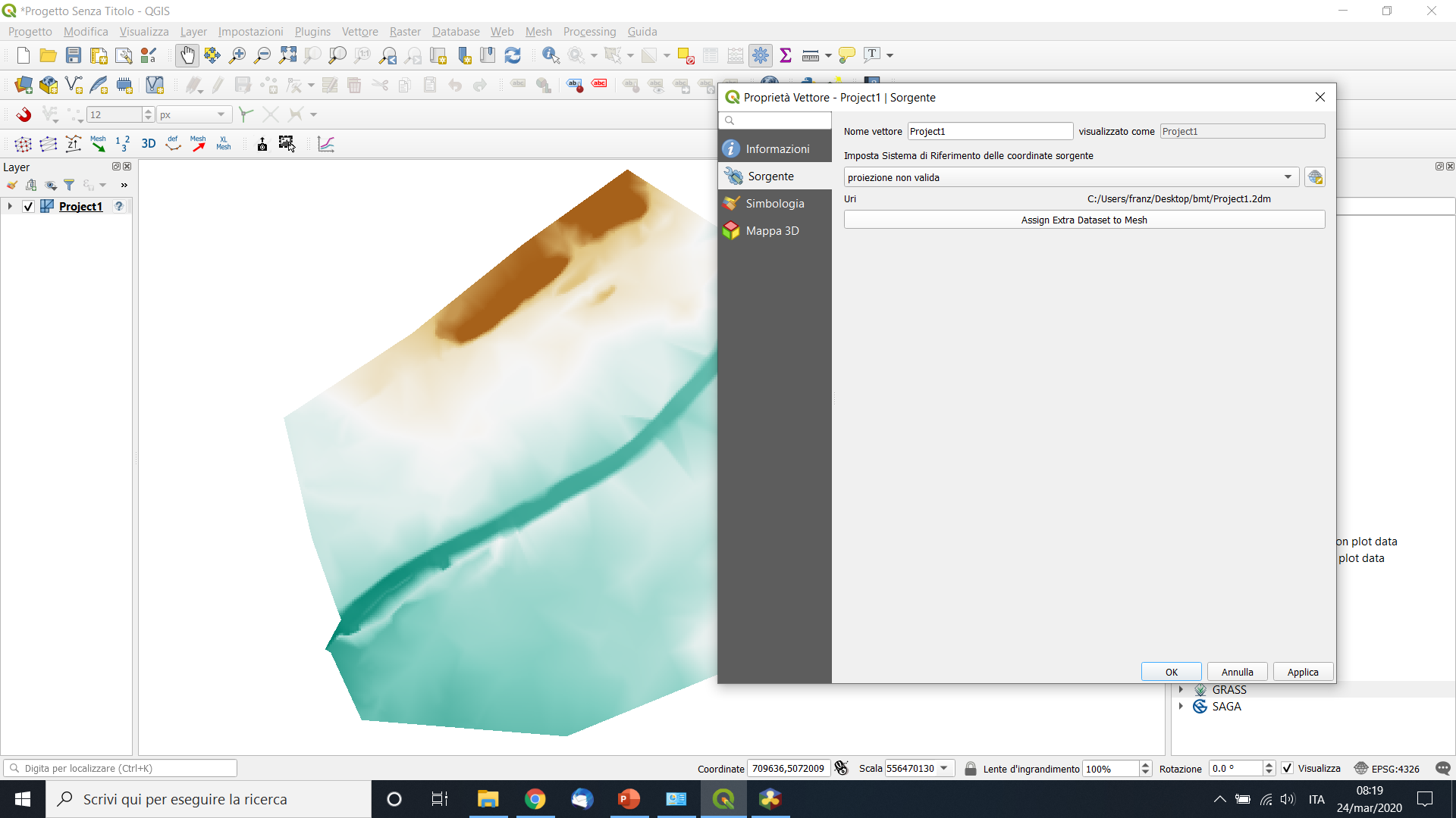
3. Practical Training
3.3 Obtain a Flood Maps
Add results datasets (xdmf) obtained from EOPEN platform
User Training Material

Slide 31
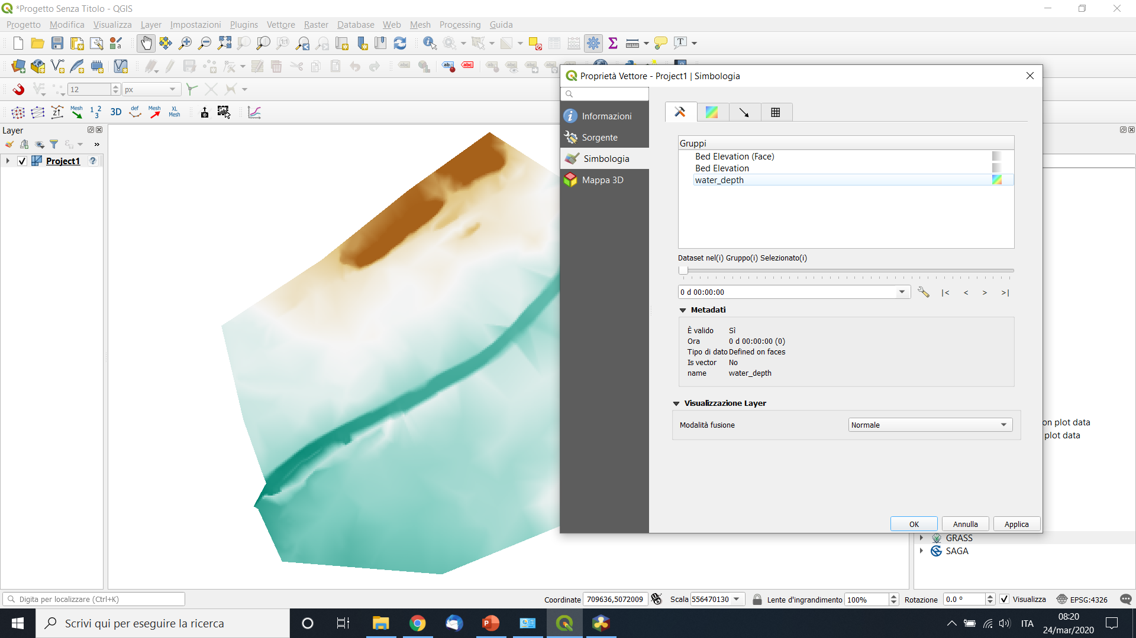
3. Practical Training
3.3 Obtain a Flood Maps
Select the corresponding variables (es. Water depth or velocity)
User Training Material

Slide 32
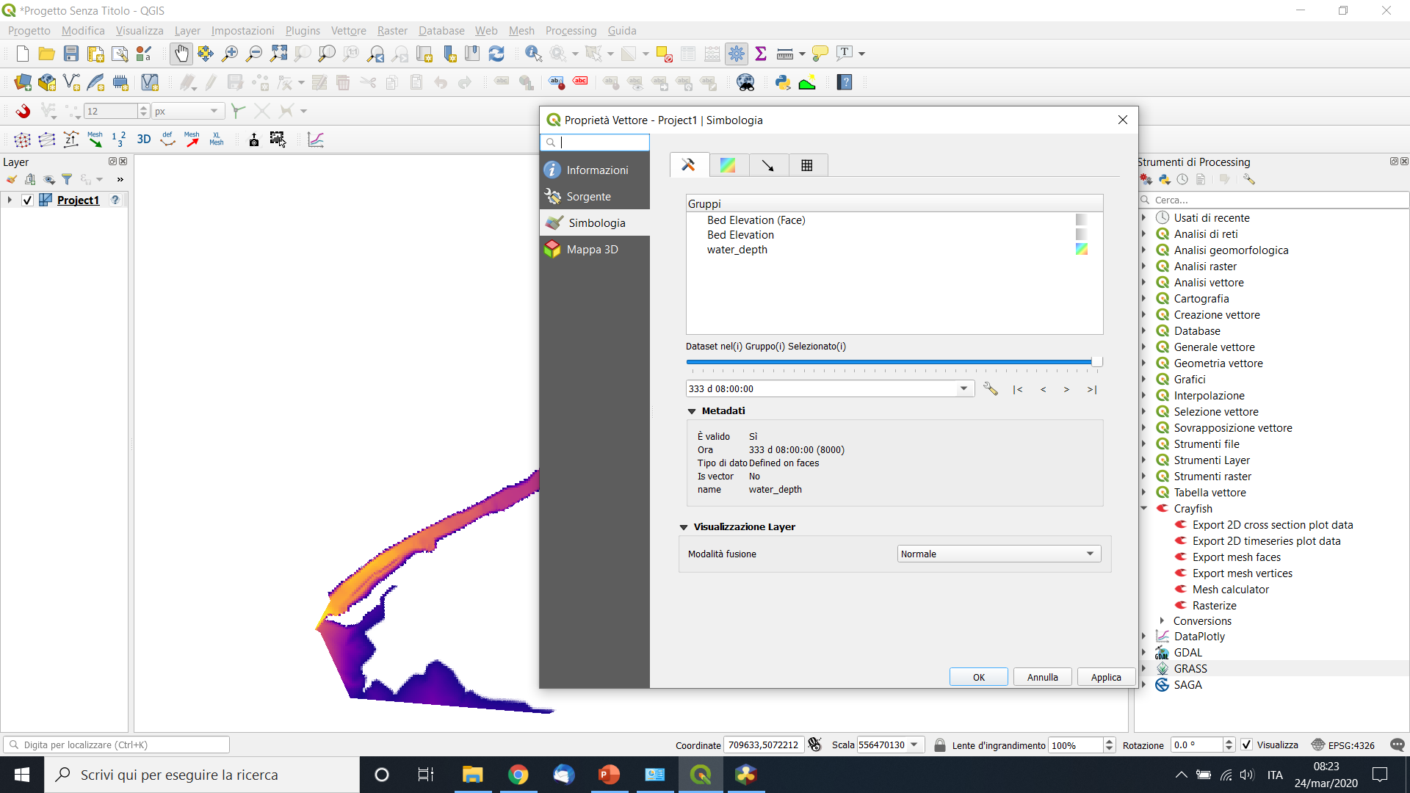
3. Practical Training
Obtain a Flood Maps
Select the time step of the simulation
User Training Material

Slide 33
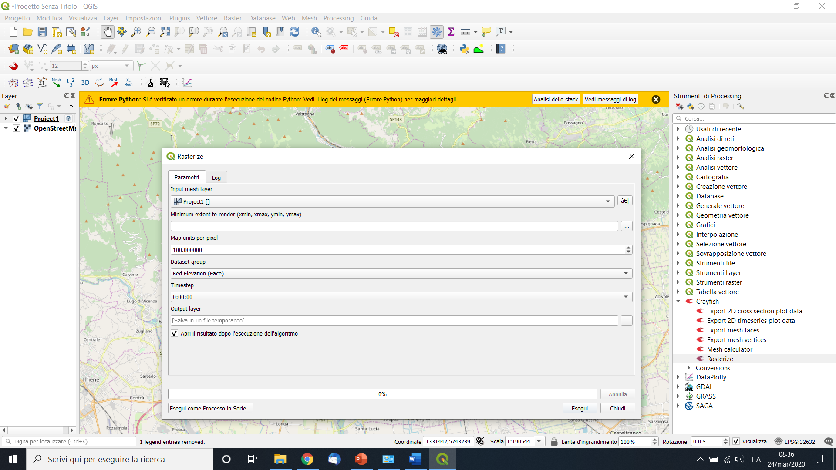
3. Practical Training
3.3 Obtain a Flood Maps
Export geotiff with crayfish plugin:
NAME CONVENTION:
AA_EWS_FF_DDMMYYstart_DDMMYYend
And upload if necessary on EOPEN
User Training Material

Slide 34
3. Practical Training
3.3 Obtain a Flood Maps
Example of flood map
User Training Material

Slide 35
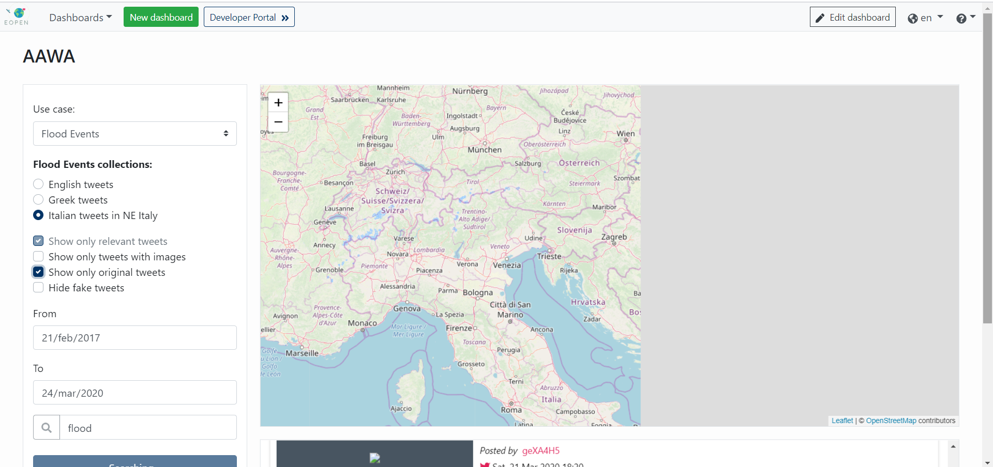
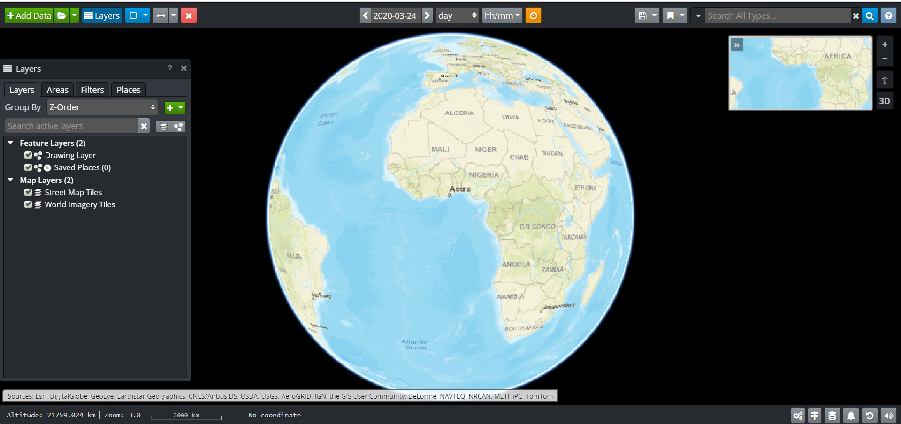
4. Visualization
Eopen provide to users different interfaces and tools to visualize results; the main tools are:
Dashboards
Opensphere (Gis viwer)
The EOPEN Geoserver (WMS service)
With this tools eachone can integrate
the platform inside their workflows
and offices.
User Training Material

Slide 36
4. Visualization
4.1 Dashboards
Dashboards
User Training Material

Slide 37
4. Visualization
4.1 Dashboards
Create a Dashboard
User Training Material

Slide 38
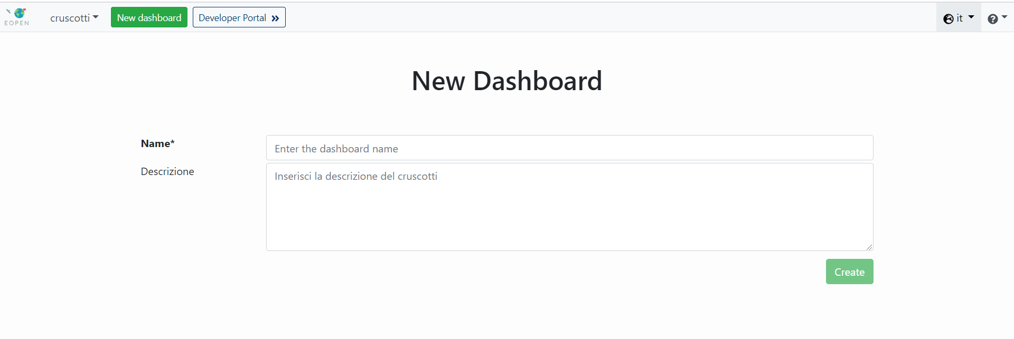
4. Visualization
4.1 Dashboards
Create a Dashboard
User Training Material

Slide 39
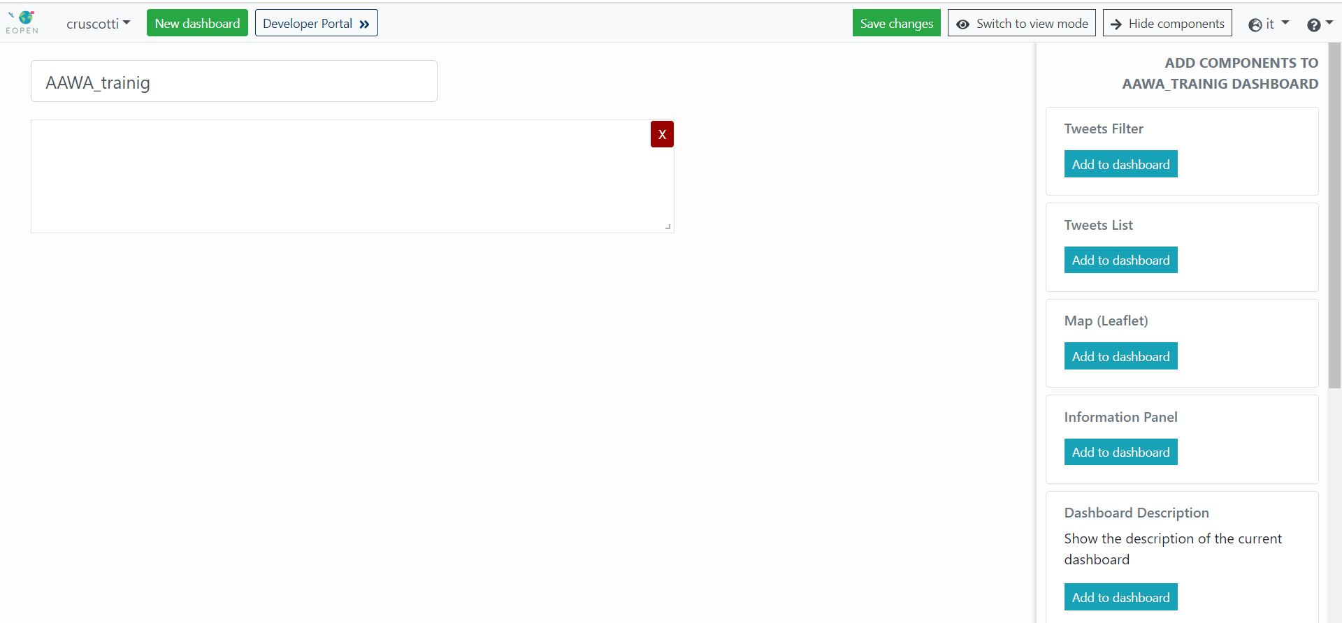
4. Visualization
4.1 Dashboards
Create a Dashboard
User Training Material

Slide 40
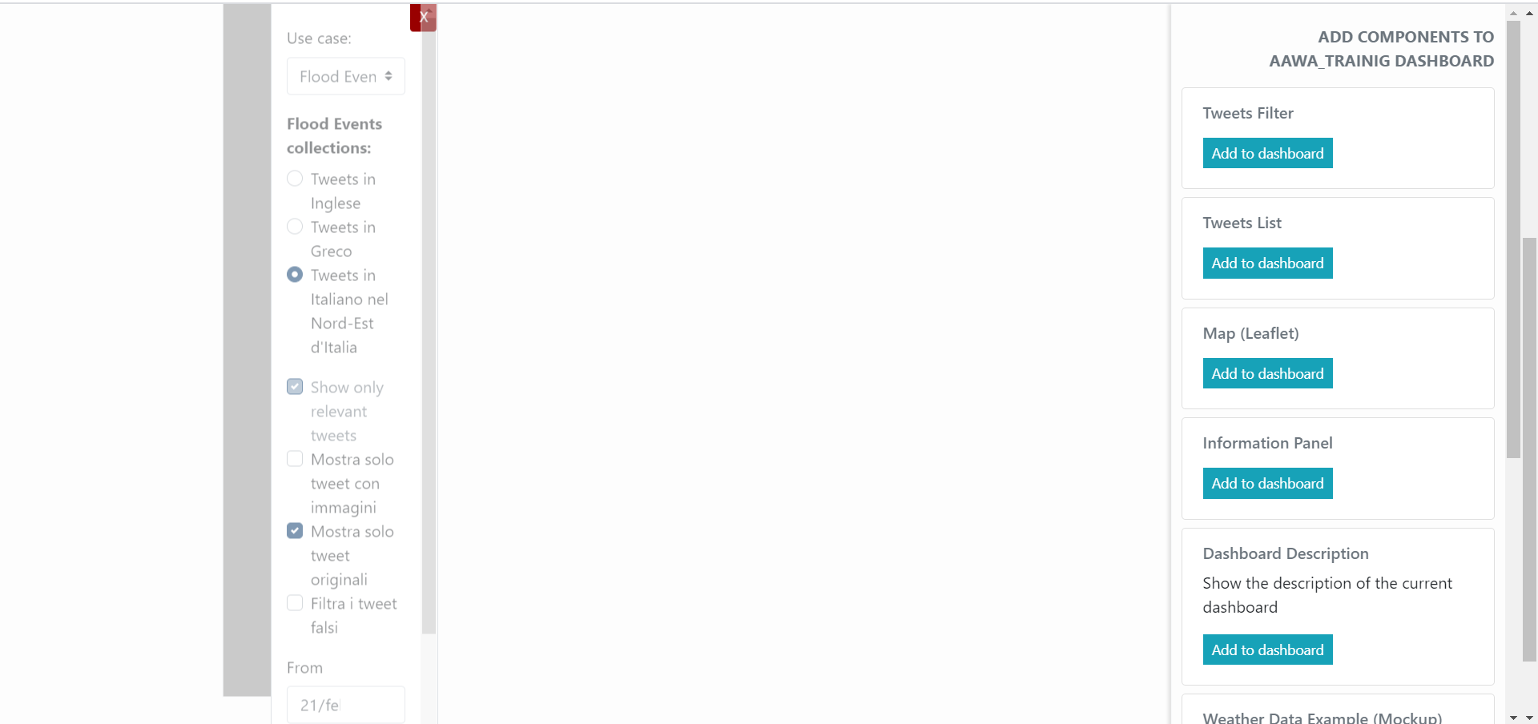
4. Visualization
4.1 Dashboards
Create a Dashboard
Add and move elements
User Training Material

Slide 41
4. Visualization
4.2 Tweet visualization
How to visualize tweets
Filters
User Training Material

Slide 42
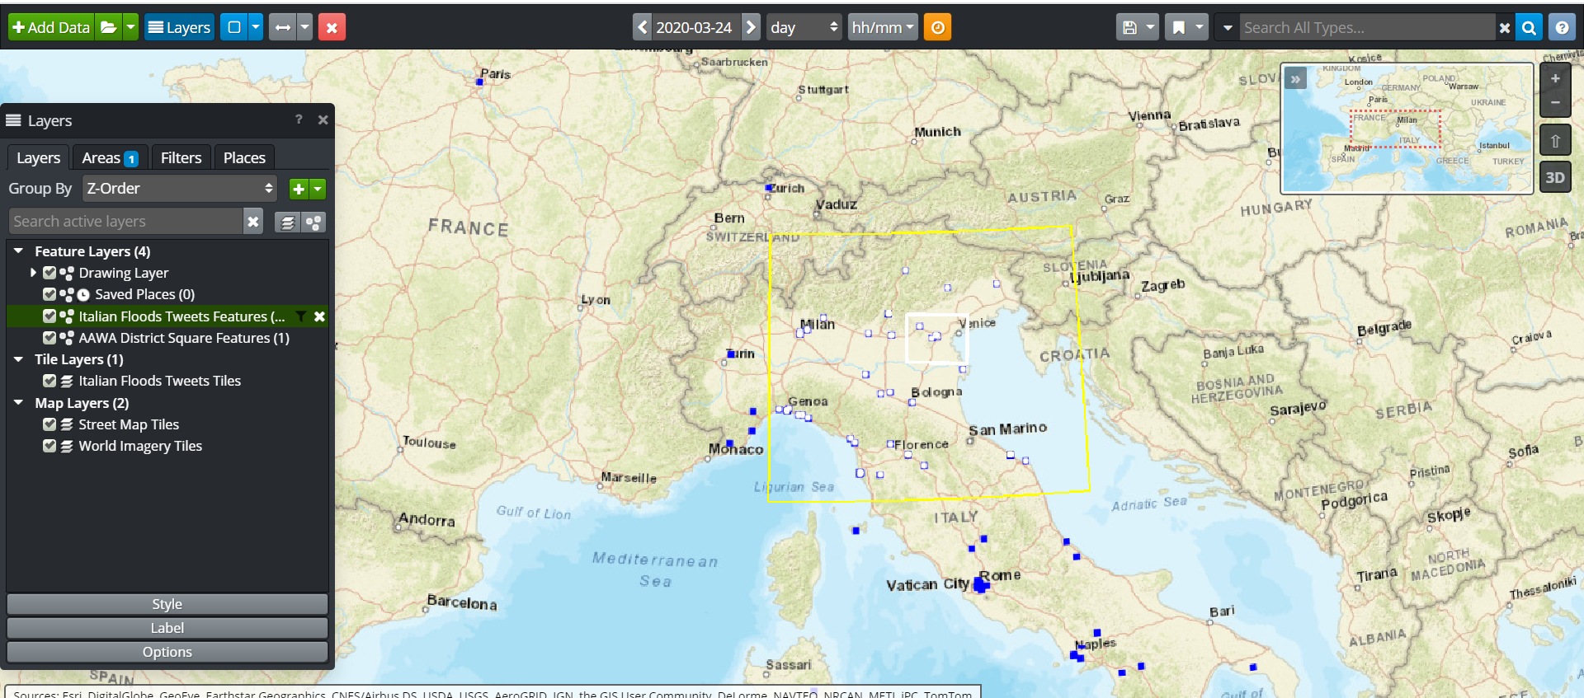
4. Visualization
4.2 Tweet visualization
How to visualize tweets in the geoserver
1- select tweet layer
2- draw a box or an AOI
3- right click, query, load
Selected features becomes white
User Training Material

Slide 43
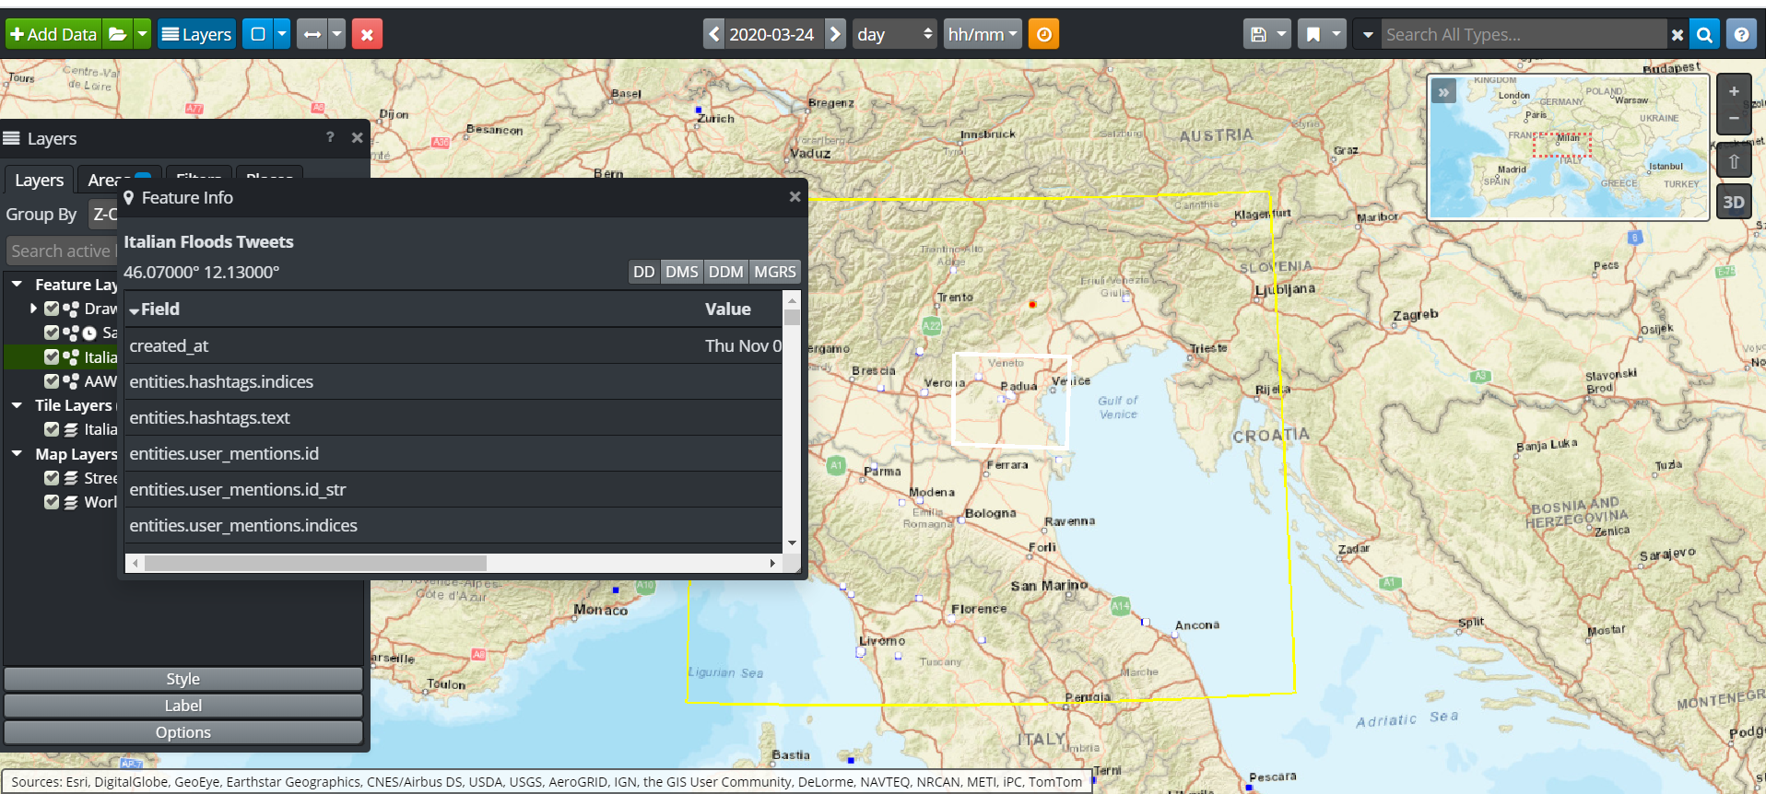
4. Visualization
4.2 Tweet visualization
How to visualize tweets in the geoserver
Select the feature layer (eg. Italian tweets)
Double click on point and the map shows the selected tweet
User Training Material

Slide 44
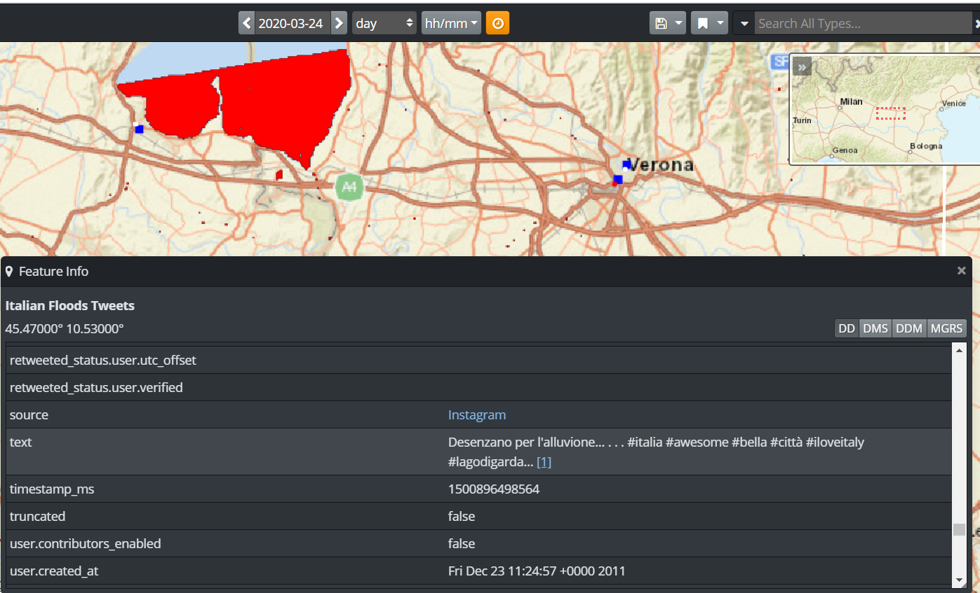
4. Visualization
4.2 Tweet visualization
Ground truth inside EOPEN
User Training Material

Slide 45
4. Visualization
1) PUC 1
Time controls
The WebGis interface
Mini map
Data Panel
Map
Layer Panel
User Training Material

Slide 46
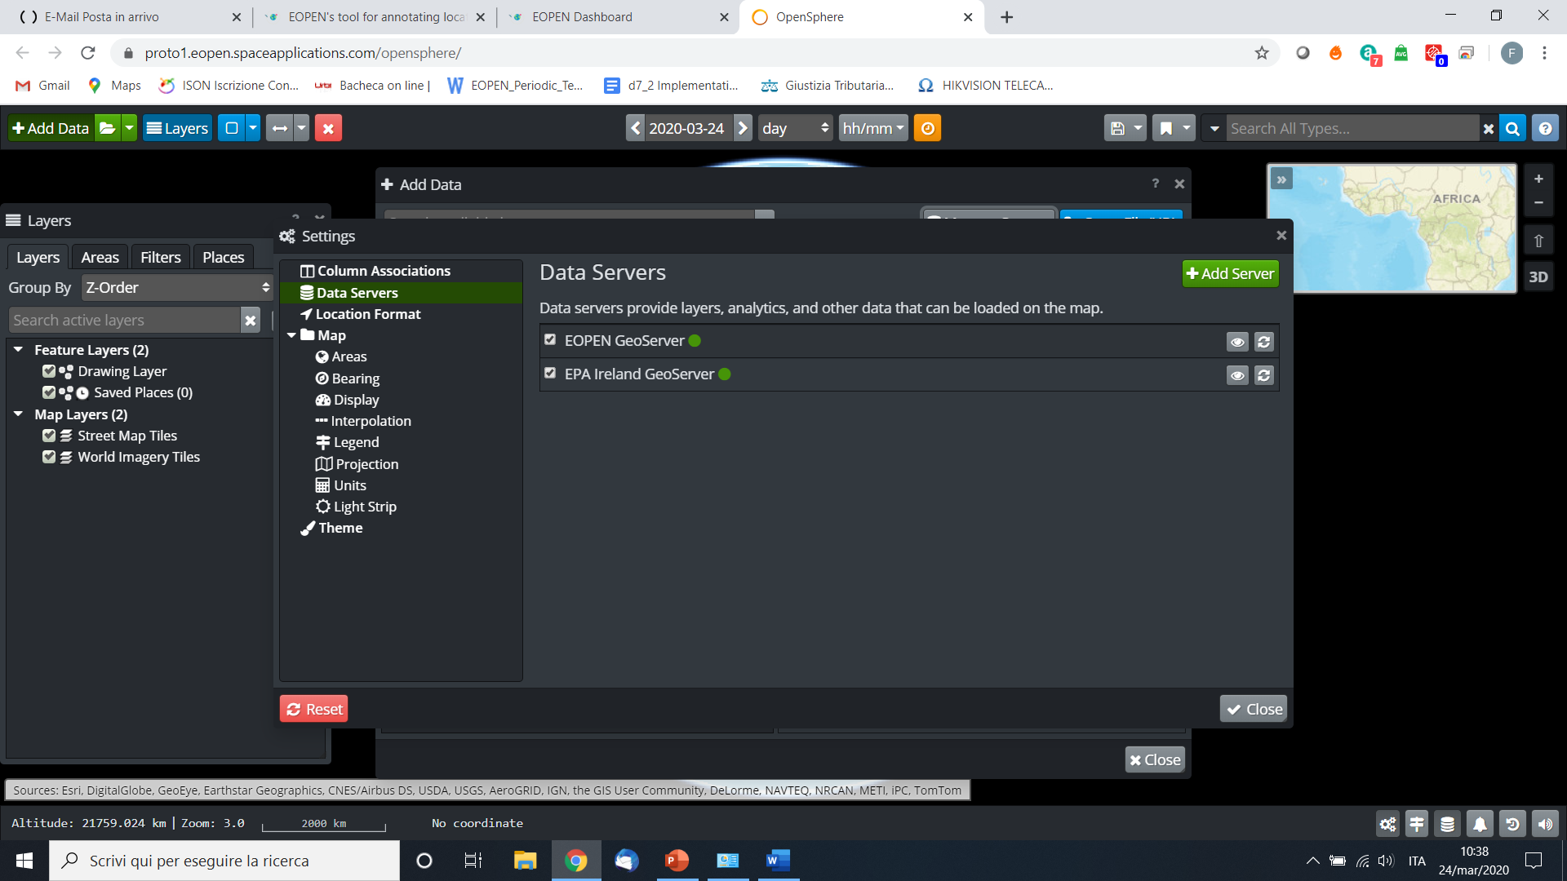
4. Visualization
Time controls
1) PUC 1
The WebGis interface
Data Panel
Services and geoservers
View options
User Training Material

Slide 47
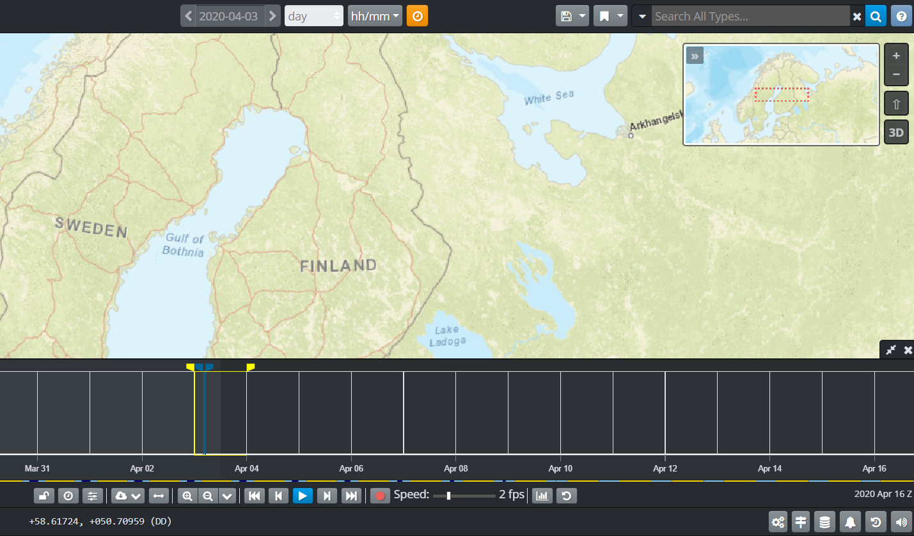
4. Visualization
1) PUC 1
The WebGis interface, time controls
User Training Material

Slide 48
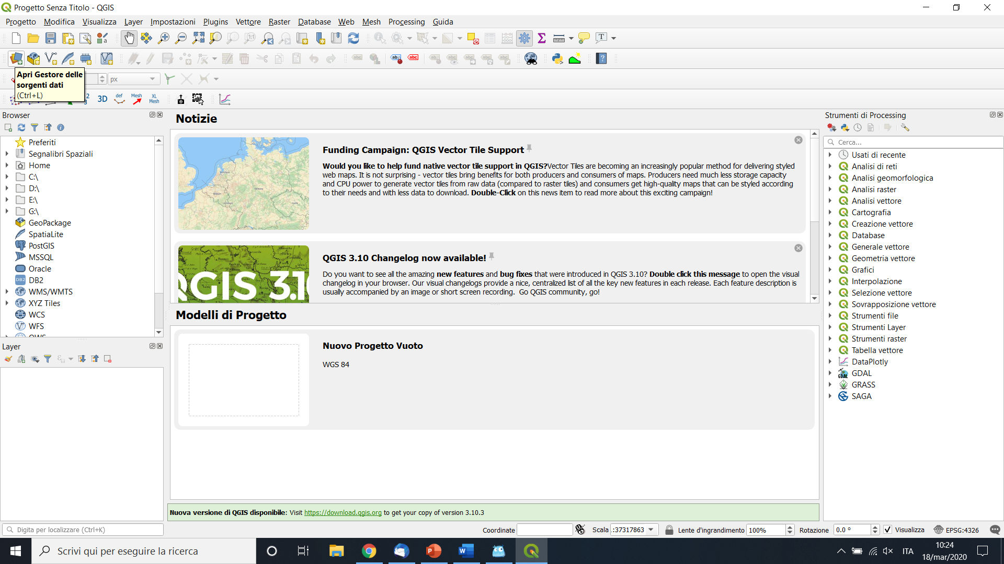
4. Visualization
1) PUC 1
EOPEN as a Geoserver
1- Open Qgis
User Training Material

Slide 49
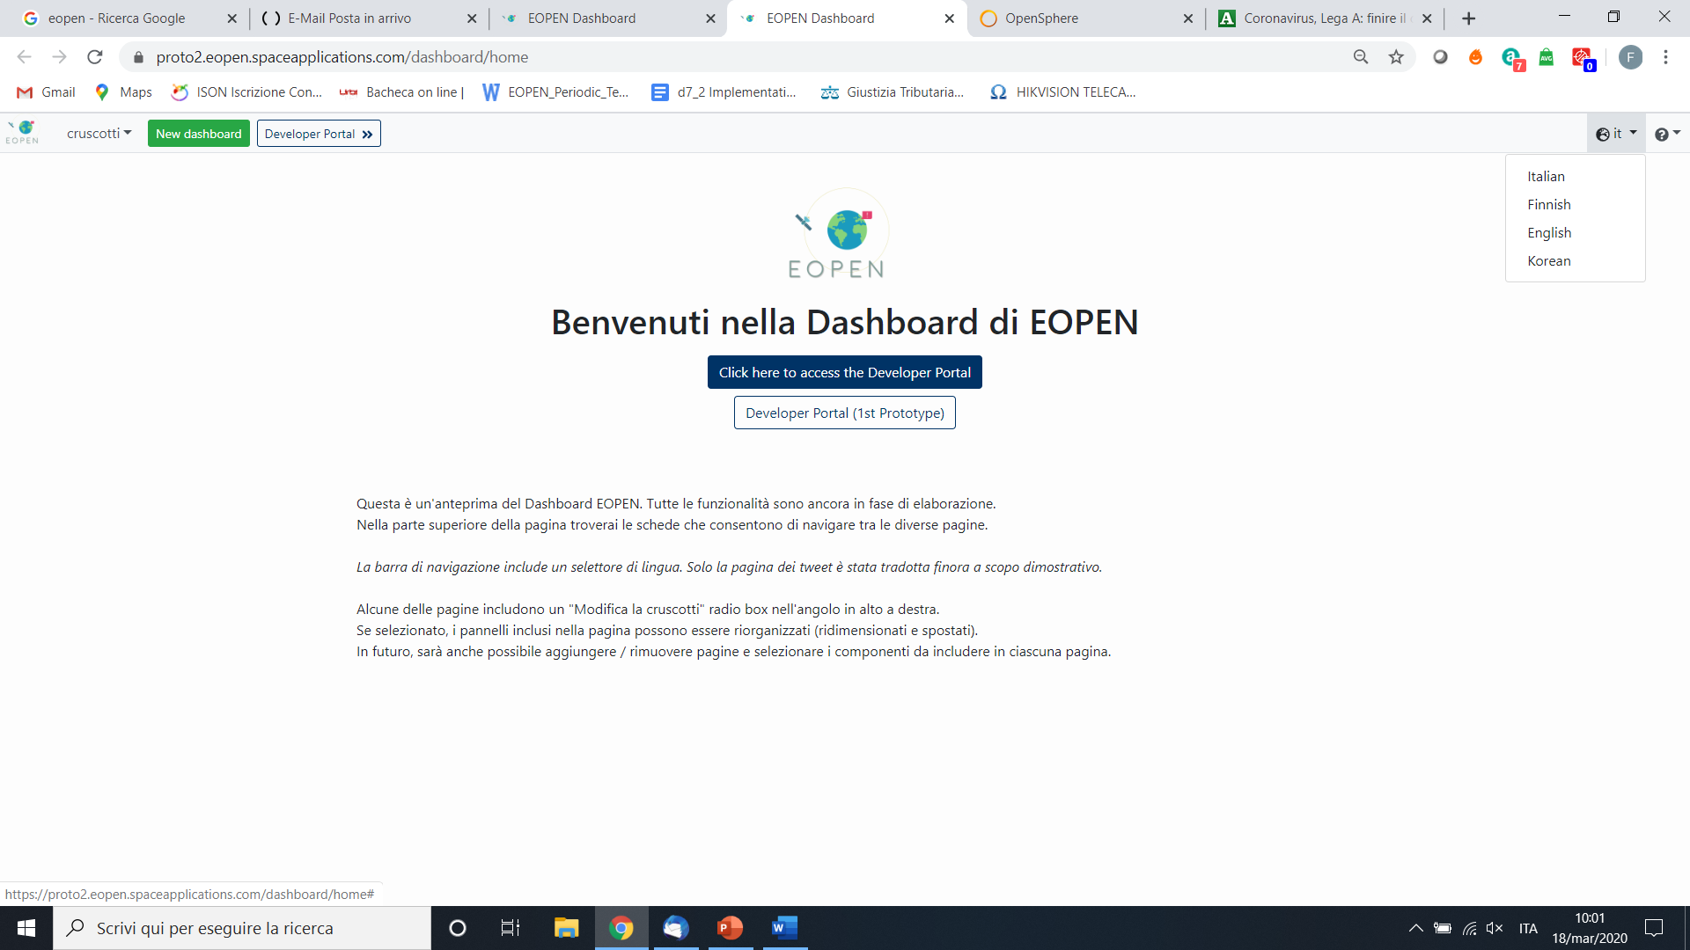
4. Visualization
1) PUC 1
How to visualize a WPM
1- change language
User Training Material

Slide 50
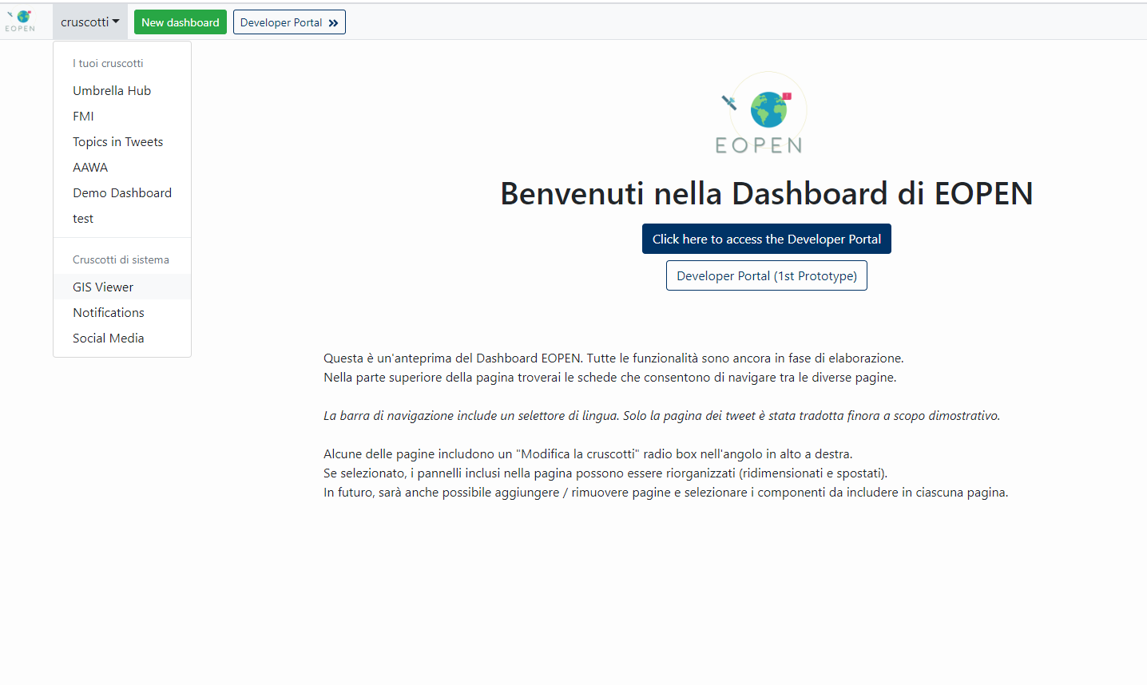
4. Visualization
1) PUC 1
How to visualize a WPM
2- select Gis Viwer
User Training Material

Slide 51
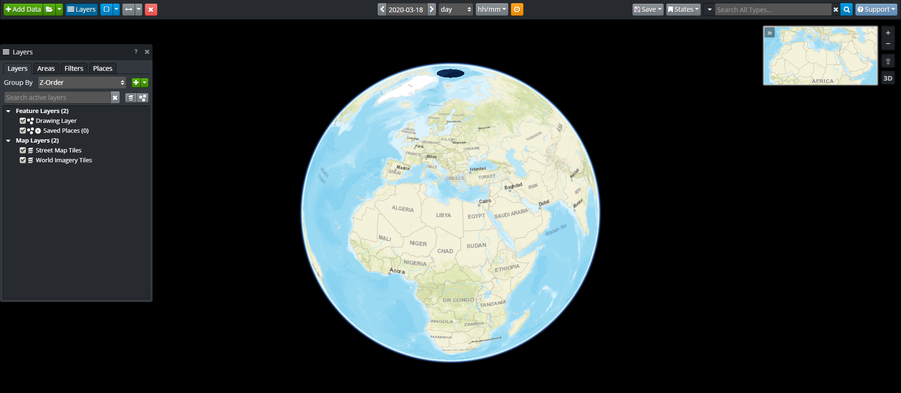
4. Visualization
1) PUC 1
How to visualize a WPM
3- access to EOPEN geoserver
User Training Material

Slide 52
4. Visualization
1) PUC 1
EOPEN as a Geoserver
2- Select add WMS layer
User Training Material

Slide 53
4. Visualization
1) PUC 1
EOPEN as a Geoserver
3- Add
https://proto2.eopen.spaceapplications.com/geoserver/ows
User Training Material

Slide 54
4. Visualization
How to merge different layers in a unique interface
1) PUC1
Add
User Training Material

Slide 55
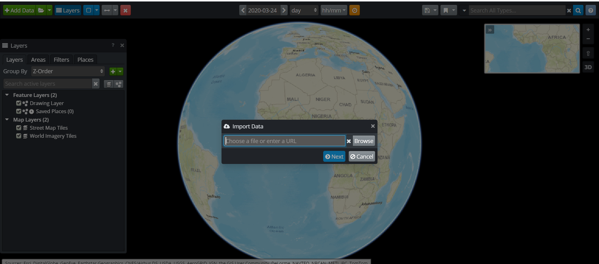
4. Visualization
How to merge different layers in a unique interface
1) PUC1
User Training Material

Slide 56
4. Visualization
How to merge different layers in a unique interface
1) PUC1
Add
User Training Material

Slide 57
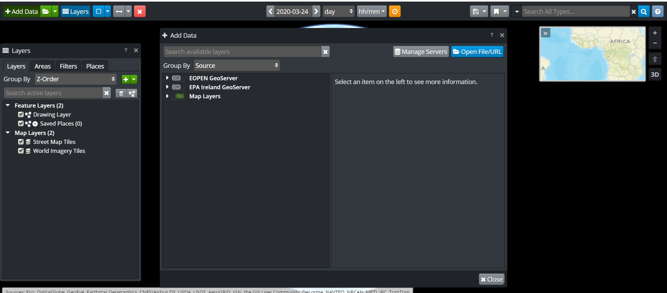
4. Visualization
How to merge different layers in a unique interface
1) PUC1
User Training Material

Slide 58
4. Visualization
How to merge different layers in a unique interface
1) PUC1
User Training Material

Slide 59
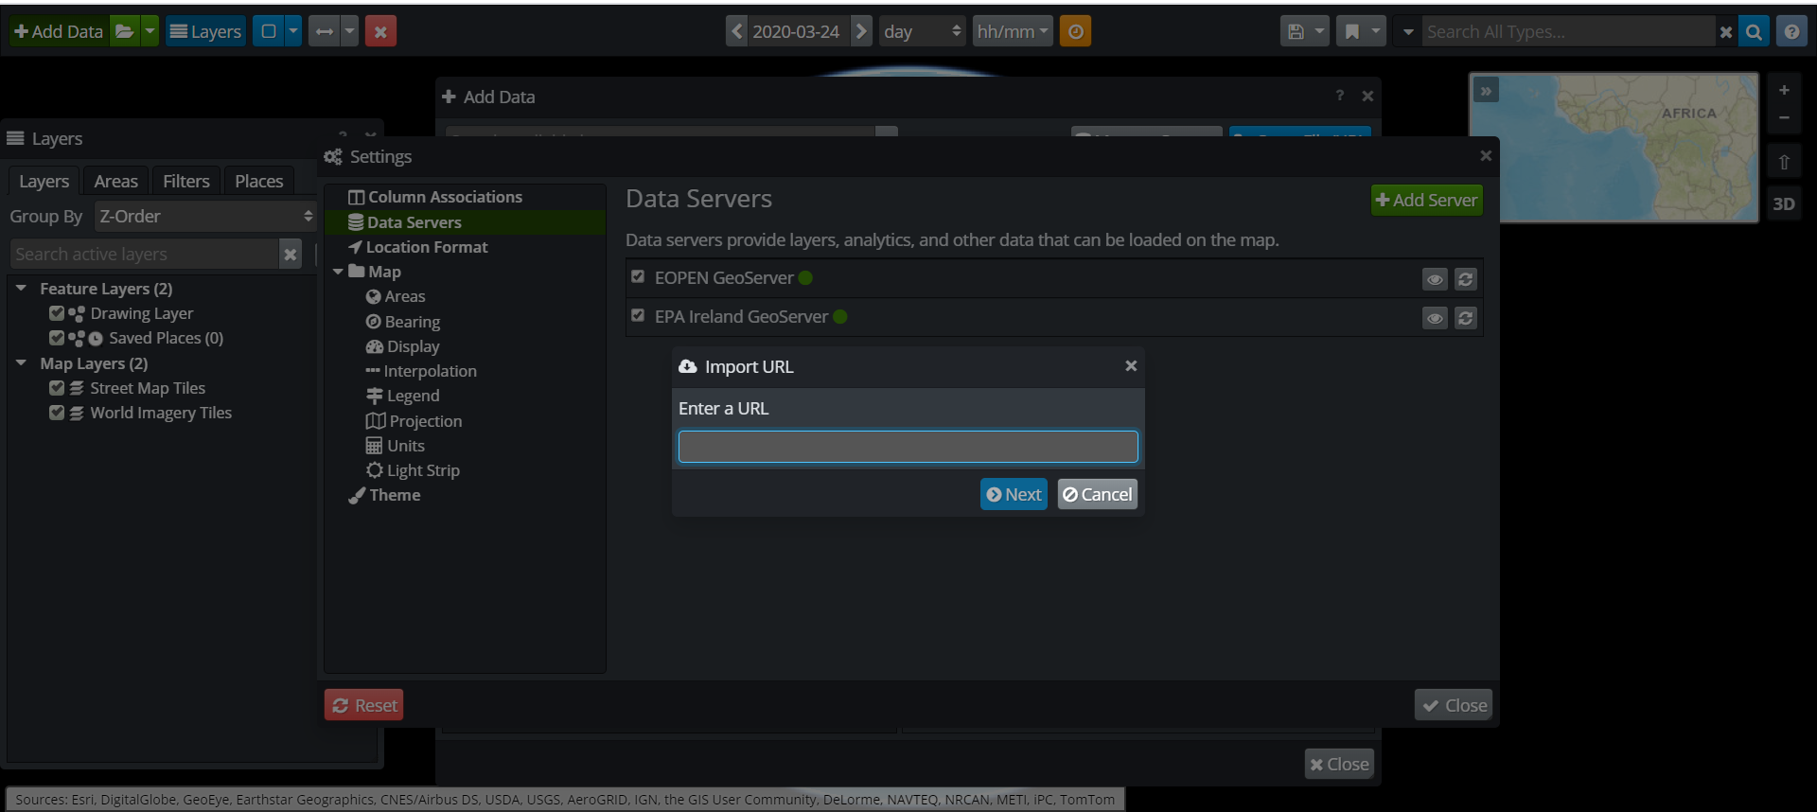
4. Visualization
How to merge different layers in a unique interface
1) PUC1
User Training Material

Slide 60
Thanks!
Any questions?
This project has received funding from the European Union’s Horizon 2020 research and innovation programme under grant agreement 776019

